Slide 1
Custard Fall
Pitch from June 5th 2022
Led by JustGreg, releasing October 16th 2022
Unity3D 2021.3.3f1

Slide 2
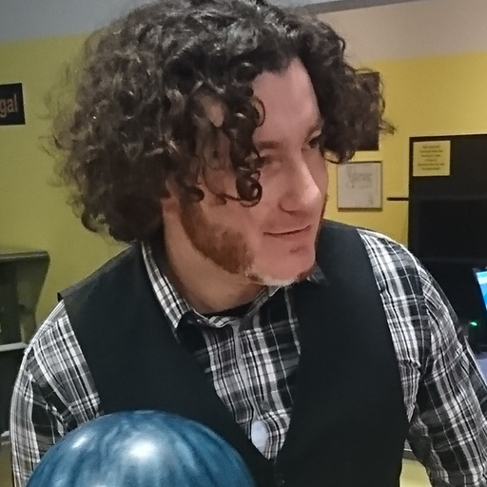
Meet JustGreg
(Grygoriy Kulesko)
Second time project lead
Three times game changer
Programmer by day but also enjoy 3d modelling, sound design and UX thinking

Slide 3
Previous
Project on HomeTeam
Ionic Defender (2021)
Also contributed to eden-sky-tower, Pawsome-Space-Barge, daggers-gate, grimsnap and witches-and-guns

Slide 4
Different Types of Apocalypse
Survival in a post apocalyptic world:
Zombies? Lone man in dead town? Dystopian space tale? Mutants?

Slide 5
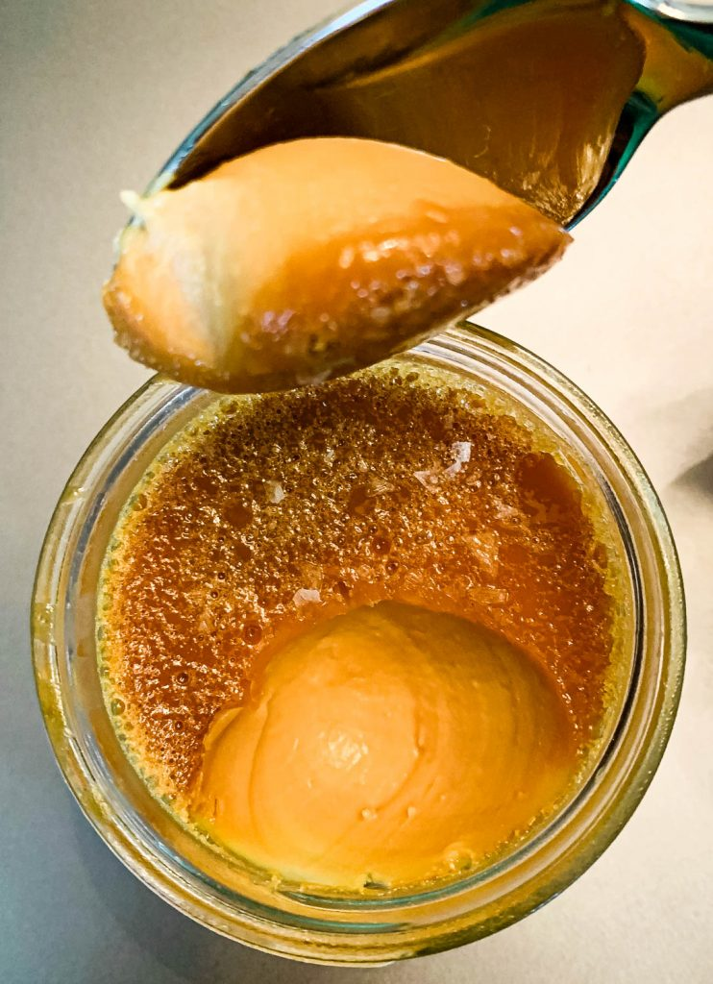
Different Types of Apocalypse
How about spicing things up with an ironic twist.
The the remains of the world as we know it are literally covered in food but it is all sweets sweets and pastry. With a Mind of its own.

Slide 6
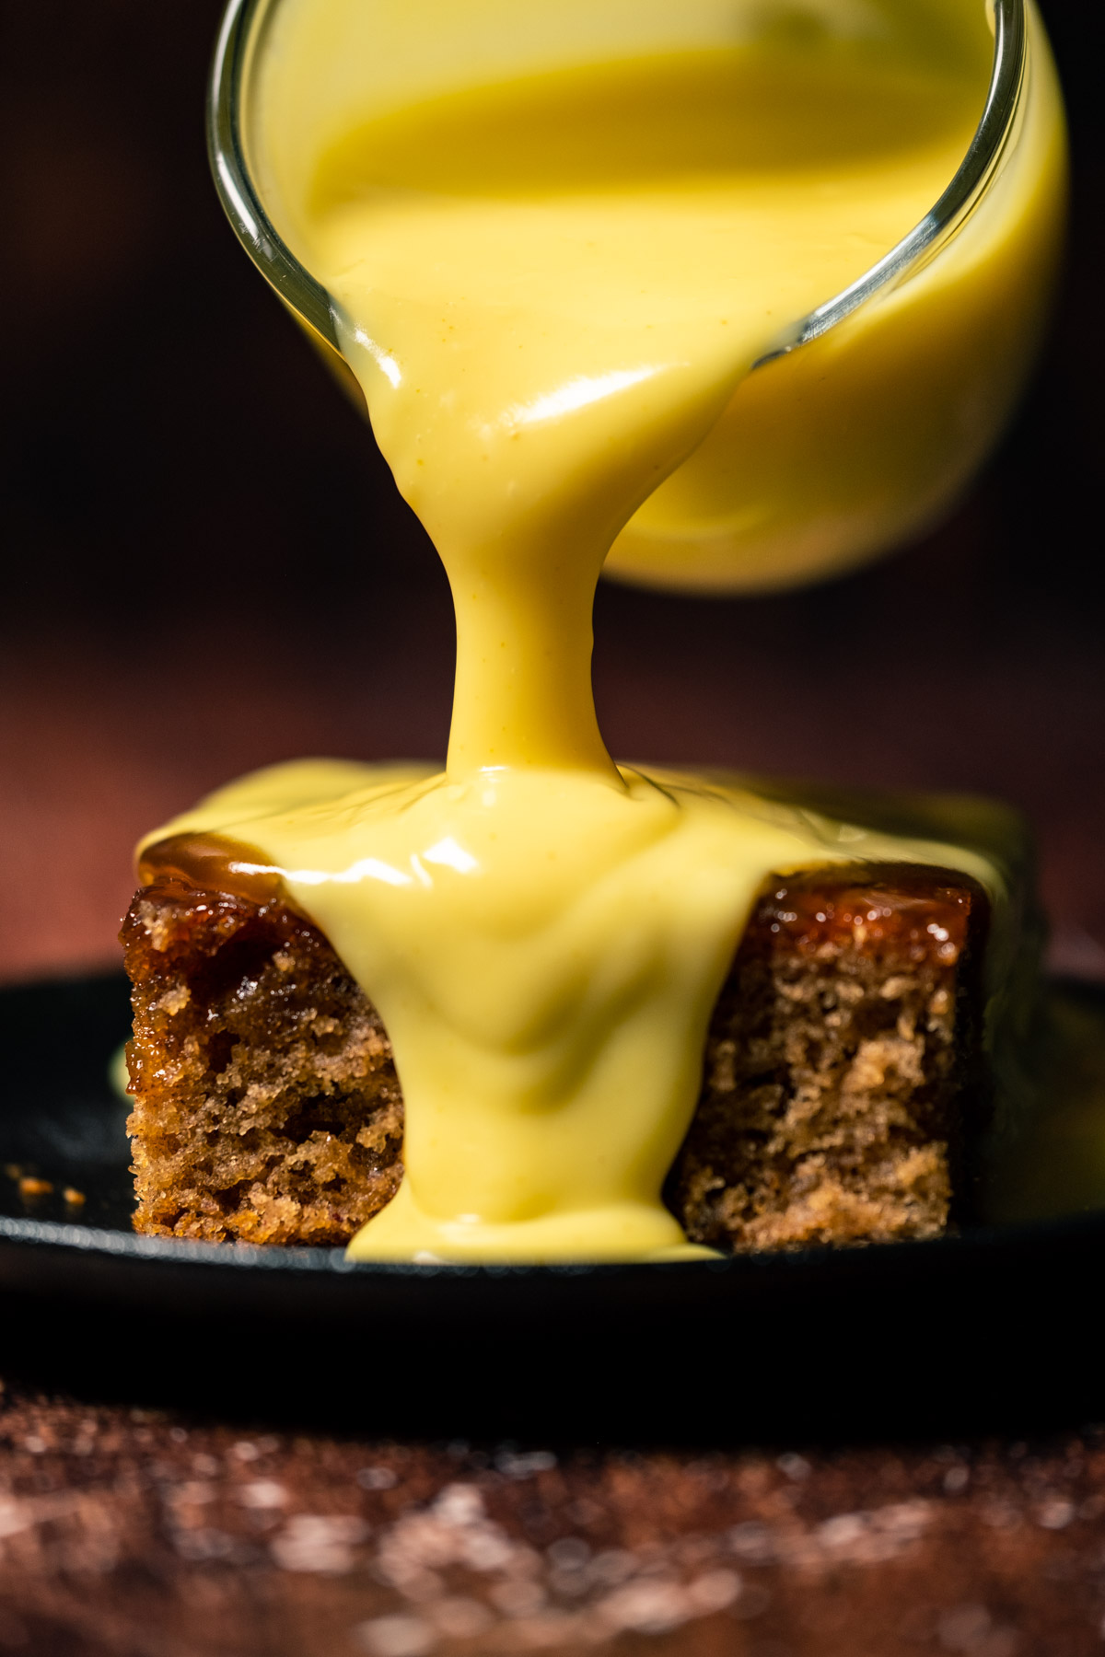
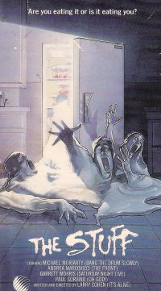
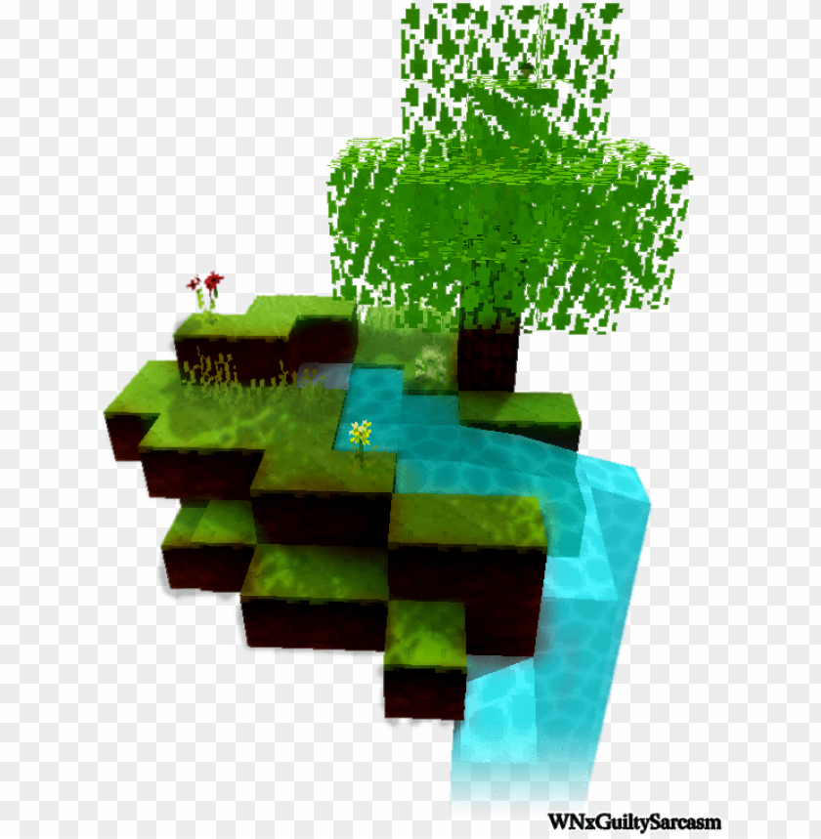
Custard Post-Apocalypse
Inspired by The Stuff (1985), Nausicaä (Ghibli, 1984) and Minecraft
At the dawn of apocalypse there was custard rain. Mix of near future with remainings of the past buried under a scifi world with its own ecosystem.

Slide 7
Inspiration for gameplay
Kirby Games
Inhaling as a core game mechanic - gather resources and use for fighting creatures

Slide 8
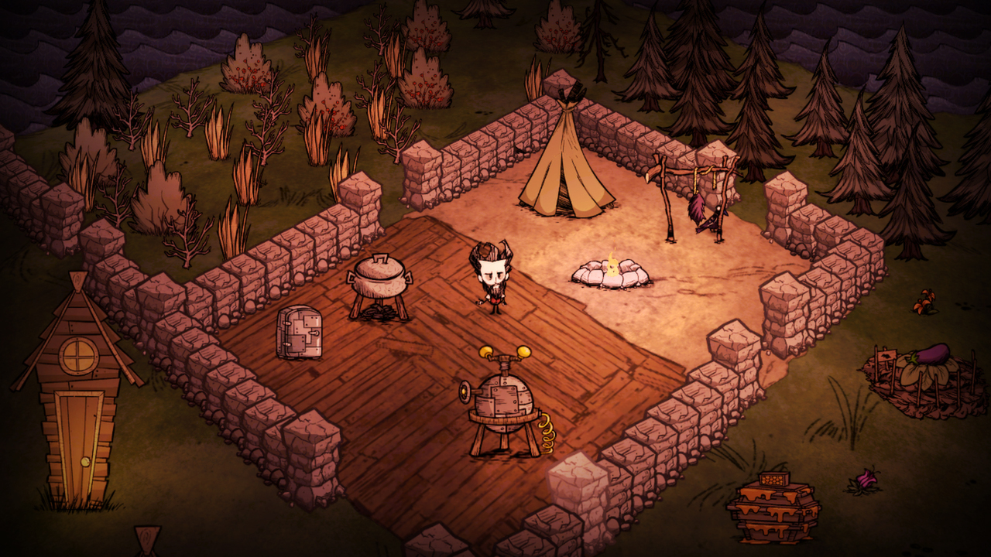
Inspiration for gameplay
Don’t Starve
Survive in a weird, hostile world by LOOTING and building structures that can help you keep alive

Slide 9
Demo Time!

Slide 10
Rough Roadmap
01
Inhale mechanic
05
Food items
02
Gather resources
06
Fighting static enemies
03
Taming the Custard
07
Feedback and polish
04
Crafting & Inventory

Slide 11
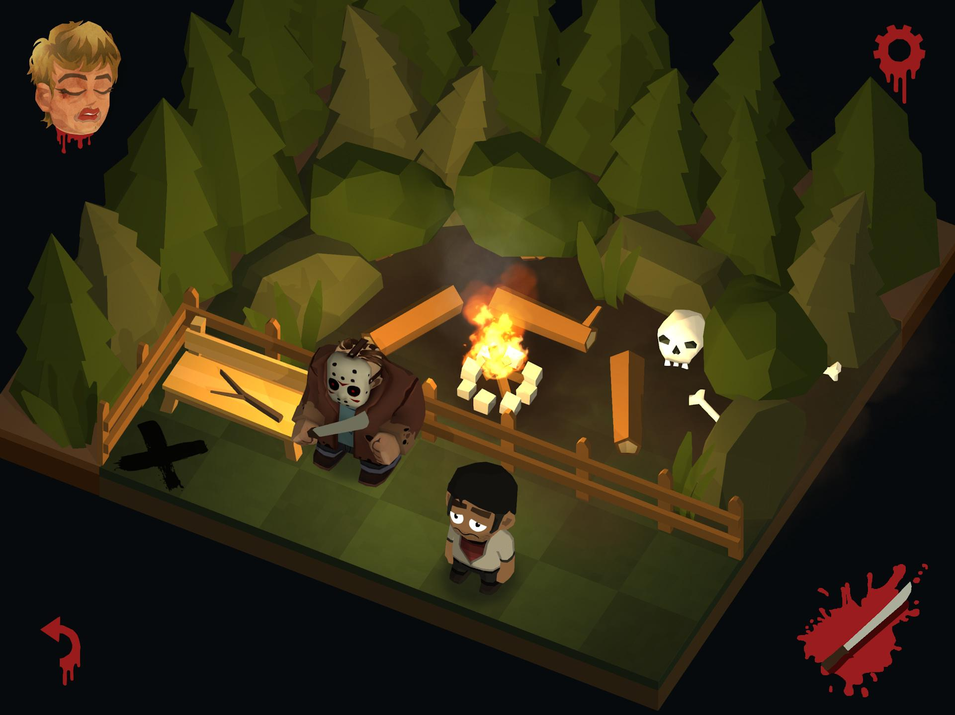
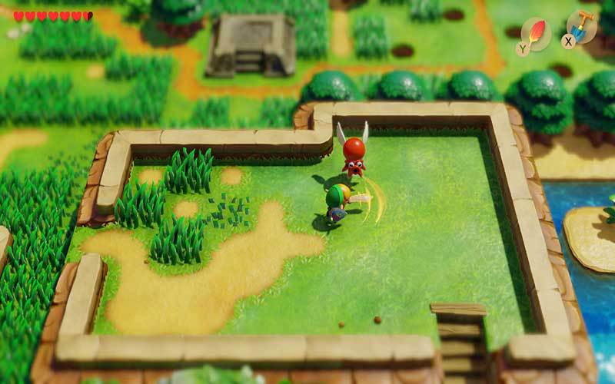
Info Sheet
Art-Style
Target Platform
World is mostly voxel based. Ramps like in Zelda are allowed, Low-Poly, ¾ Camera
PC with keyboard-mouse and gamepad controls

Slide 12
Things you can do!
Programming
Music
3D Art
Sound effects
Game HUD, crafting and inventory menus, ecosystem and player abilities
Synth with electric guitar - ideally adaptive
Expressive low-poly level design, player animation and a lot of items and structures
A lot of foley sfx on terrain and custard and feedback and environmental sounds

Slide 13
Schedule is up on trello!

Slide 14
Come join us on
#team-custard-fall

Slide 15
THANKS!
Do you have any questions?
youremail@freepik.com
+91 620 421 838
yourcompany.com
Please keep this slide for attribution

